Slide 1
XGBoost (eXtreme Gradient Boosting)
It is an open-source machine learning library.
It uses gradient boosted decision trees to solve data science problems.
It's known for being fast, efficient, and able to scale well with large datasets.

Slide 2
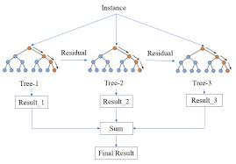
Gradient boosted trees are used to evaluate the final result.

Slide 3
XGBoost library, also known as multiple additive regression trees, stochastic gradient boosting, or gradient boosting machines

Slide 4
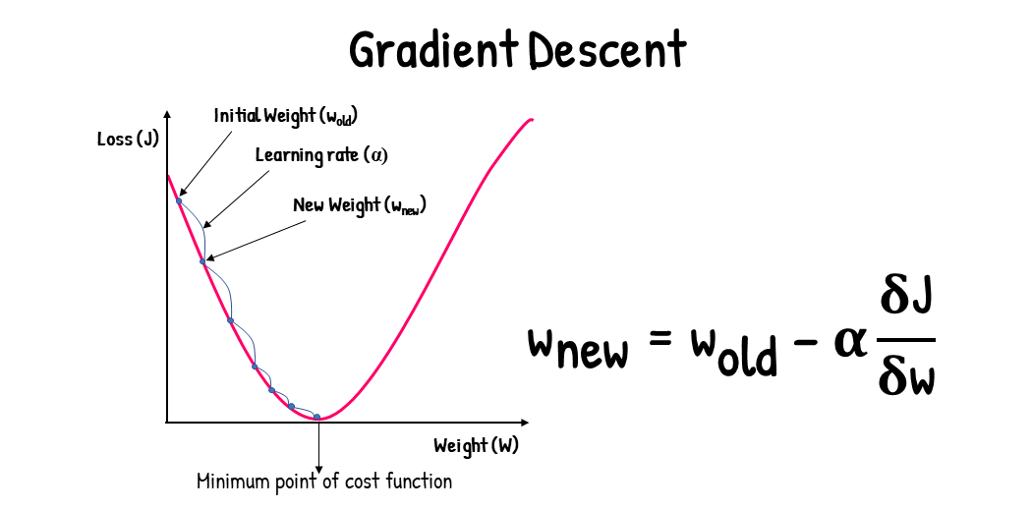
XGBoost is a robust algorithm that can help you improve your machine-learning model's accuracy.
Gradient Boosting (GBM) works on the principle gradient descent algorithm.

Slide 5
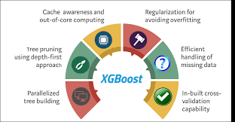
XGBoost comes along with a lot of parameters, its also known as “King of ML Algorithms”

Slide 6
XGboost advantage, disadvantage and applications:
Advantage:
Fast training speed, parallel computing capabilities
Excellent performance with large datasets.
Disadvantage:
Data imbalance and overfitting
Applications:
Predictive modeling, time series forecasting, and customer churn prediction

